Slide 1
The Chemistry of Acids and Bases
Notes:
To play the movies and simulations included, view the presentation in Slide Show Mode.

Slide 2
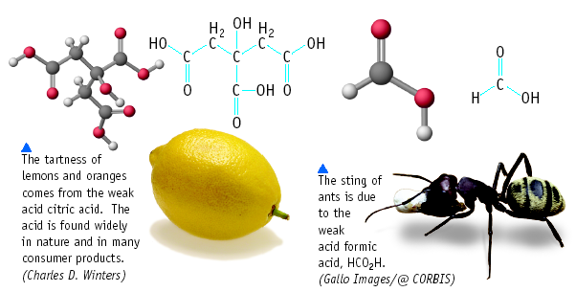
Acid and Bases

Slide 3
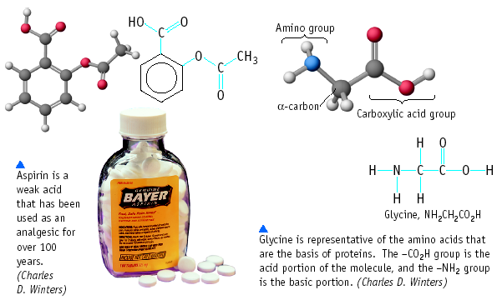
Acid and Bases

Slide 4
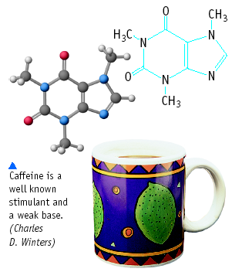
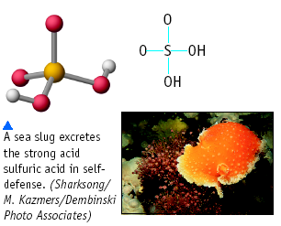
Acid and Bases

Slide 5
Acids
Have a sour taste. Vinegar is a solution of acetic acid. Citrus
fruits contain citric acid.
React with certain metals to produce hydrogen gas.
React with carbonates and bicarbonates to produce carbon
dioxide gas
Bases
Have a bitter taste.
Feel slippery. Many soaps contain bases.

Slide 6
Some Properties of Acids
Produce H⁺ (as H₃O⁺) ions in water (the hydronium ion is a hydrogen ion attached to a water molecule)
Taste sour
Corrode metals
Electrolytes
React with bases to form a salt and water
pH is less than 7
Turns blue litmus paper to red “Blue to Red A-CID”

Slide 7
Acid Nomenclature Review
No Oxygen→
w/Oxygen
An easy way to remember which goes with which…
“In the cafeteria, you ATE something ICky”

Slide 8
Acid Nomenclature Flowchart

Slide 9
Acid Nomenclature Review
HBr _{(aq)}
H₂CO₃
H₂SO₃
⇒ hydrobromic acid
⇒ carbonic acid
⇒ sulfurous acid

Slide 10

Name ‘Em!
HI _{(aq)}
HCl _{(aq)}
H₂SO₃
HNO₃
HIO₄

Slide 11
Some Properties of Bases
Produce OH⁻ ions in water
Taste bitter, chalky
Are electrolytes
Feel soapy, slippery
React with acids to form salts and water
pH greater than 7
Turns red litmus paper to blue “Basic Blue”

Slide 12
Some Common Bases
NaOH sodium hydroxide lye
KOH potassium hydroxide liquid soap
Ba(OH)₂ barium hydroxide stabilizer for plastics
Mg(OH)₂ magnesium hydroxide “MOM” Milk of magnesia
Al(OH)₃ aluminum hydroxide Maalox (antacid)

Slide 13
Acid/Base definitions
Definition #1: Arrhenius (traditional)
  Acids – produce H⁺ ions (or hydronium ions H₃O⁺)
  Bases – produce OH⁻ ions
  (problem: some bases don’t have hydroxide ions!)

Slide 14
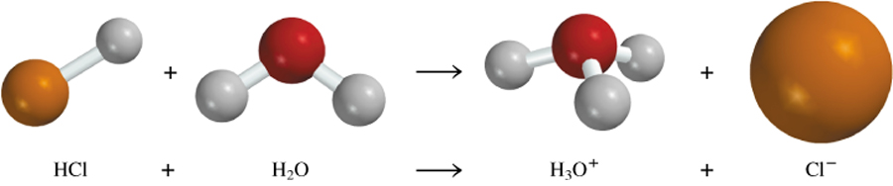
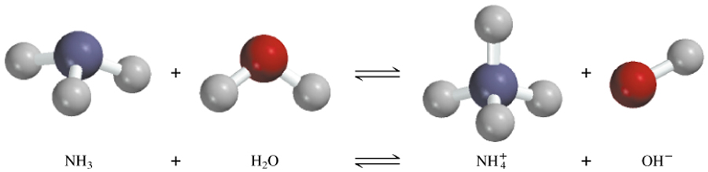
Arrhenius acid is a substance that produces H⁺ (H₃O⁺) in water
Arrhenius base is a substance that produces OH⁻ in water

Slide 15
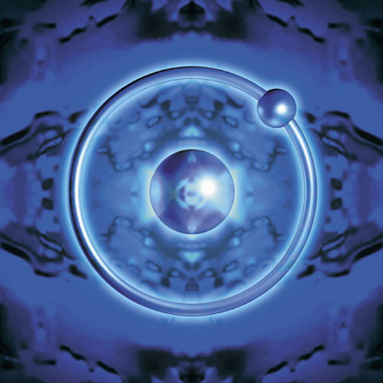
Acid/Base Definitions
Definition #2: Brønsted – Lowry
  Acids – proton donor
  Bases – proton acceptor
  A “proton” is really just a hydrogen atom that has lost it’s electron!

Slide 16
A Brønsted-Lowry acid is a proton donor
A Brønsted-Lowry base is a proton acceptor
conjugate acid
conjugate base
base
acid

Slide 17
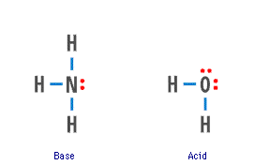
ACID-BASE THEORIES
The Brønsted definition means NH₃ is a BASE in water — and water is itself an ACID

Slide 18
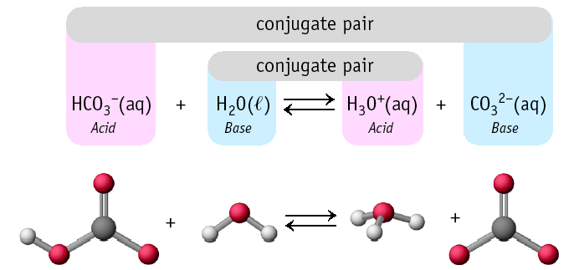
Conjugate Pairs

Slide 19
Learning Check!
HONORS ONLY!
Label the acid, base, conjugate acid, and conjugate base in each reaction:
HCl + OH⁻ → Cl⁻ + H₂O
H₂O + H₂SO₄ → HSO₄⁻ + H₃O⁺

Slide 20
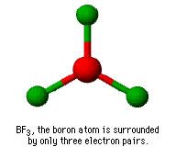
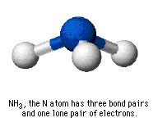
Acids & Base Definitions
Definition #3 – Lewis
Lewis acid - a substance that accepts an electron pair
Lewis base - a substance that donates an electron pair

Slide 21
Lewis Acids & Bases
Formation of hydronium ion is also an excellent example.
Electron pair of the new O-H bond originates on the Lewis base.

Slide 22
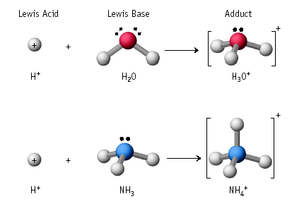
Lewis Acid/Base Reaction

Slide 23
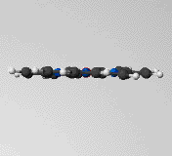
Lewis Acid-Base Interactions in Biology
The heme group in hemoglobin can interact with O₂ and CO.
The Fe ion in hemoglobin is a Lewis acid
O₂ and CO can act as Lewis bases
Heme group

Slide 24
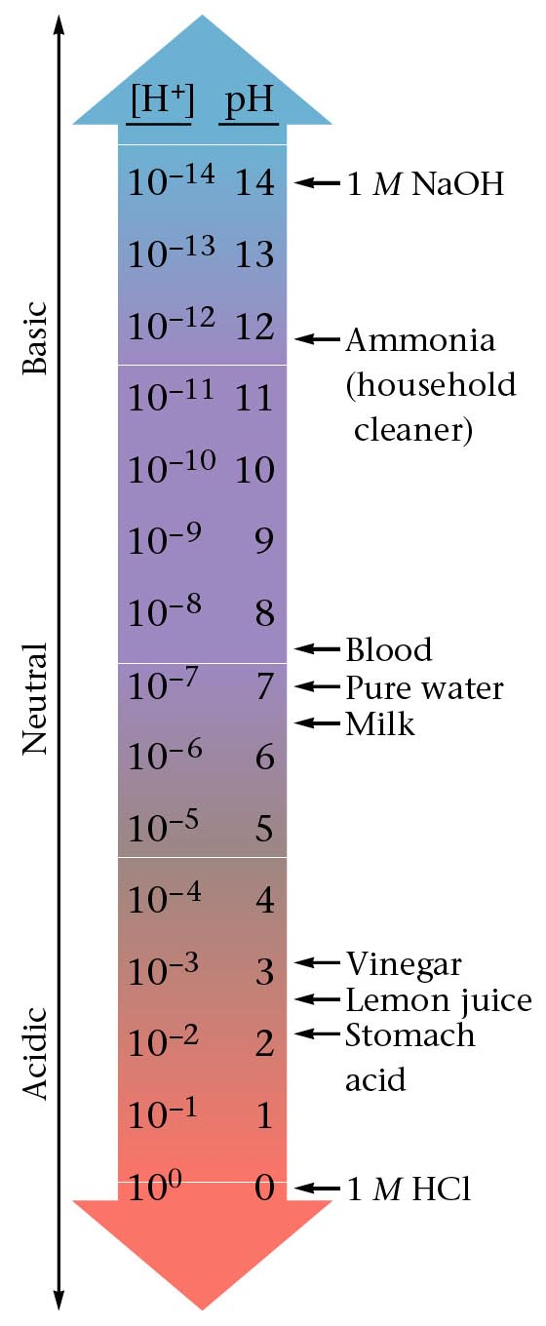
The pH scale is a way of expressing the strength of acids and bases. Instead of using very small numbers, we just use the NEGATIVE power of 10 on the Molarity of the H⁺ (or OH⁻) ion.
Under 7 = acid
7 = neutral
Over 7 = base

Slide 25
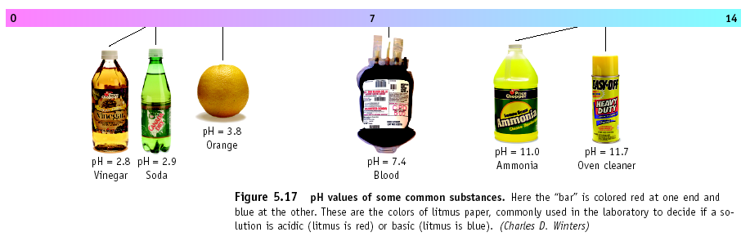
pH of Common Substances

Slide 26
Calculating the pH
pH = - log [H+]
(Remember that the [ ] mean Molarity)
Example: If [H⁺] = 1 X 10⁻¹⁰
pH = - log 1 X 10⁻¹⁰
pH = - (- 10)
pH = 10
Example: If [H⁺] = 1.8 X 10⁻⁵
pH = - log 1.8 X 10⁻⁵
pH = - (- 4.74)
pH = 4.74

Slide 27
Try These!
Find the pH of these:
1) A 0.15 M solution of Hydrochloric acid
2) A 3.00 X 10⁻⁷ M solution of Nitric acid

Slide 28
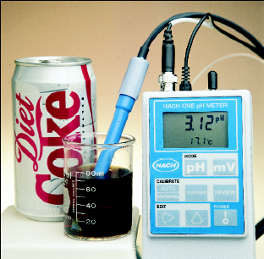
pH calculations – Solving for H+
If the pH of Coke is 3.12, [H⁺] = ???
Because pH = - log [H⁺] then
- pH = log [H⁺]
Take antilog (10^{x}) of both
sides and get
10^{-pH} = [H⁺]
[H⁺] = 10^{-3.12} = 7.6 x 10⁻⁴ M
*** to find antilog on your calculator, look for “Shift” or “2nd function” and then the log button

Slide 29
pH calculations – Solving for H+
A solution has a pH of 8.5. What is the Molarity of hydrogen ions in the solution?
pH = - log [H⁺]
8.5 = - log [H⁺]
-8.5 = log [H⁺]
Antilog -8.5 = antilog (log [H⁺])
10^{-8.5} = [H⁺]
3.16 X 10⁻⁹ = [H⁺]

Slide 30
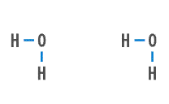
More About Water
HONORS ONLY!
H₂O can function as both an ACID and a BASE.
In pure water there can be AUTOIONIZATION
Equilibrium constant for water = K_{w}
K_{w} = [H₃O⁺] [OH⁻] = 1.00 x 10⁻¹⁴ at 25 ºC

Slide 31
More About Water
HONORS ONLY!
Autoionization
K_{w} = [H₃O⁺] [OH⁻] = 1.00 x 10⁻¹⁴ at 25 ºC
In a neutral solution [H₃O⁺] = [OH⁻]
so K_{w} = [H₃O⁺]² = [OH⁻]²
and so [H₃O⁺] = [OH⁻] = 1.00 x 10⁻⁷ M

Slide 32
pOH
Since acids and bases are opposites, pH and pOH are opposites!
pOH does not really exist, but it is useful for changing bases to pH.
pOH looks at the perspective of a base
pOH = - log [OH⁻]
Since pH and pOH are on opposite ends,
      pH + pOH = 14

Slide 33
pH
[H⁺]
[OH⁻]
pOH

Slide 34
[H₃O⁺], [OH⁻] and pH
What is the pH of the 0.0010 M NaOH solution?
[OH-] = 0.0010 (or 1.0 X 10⁻³ M)
pOH = - log 0.0010
pOH = 3
pH = 14 – 3 = 11
OR K_{w} = [H₃O⁺] [OH⁻]
[H₃O⁺] = 1.0 x 10⁻¹¹ M
pH = - log (1.0 x 10⁻¹¹) = 11.00

Slide 35
The pH of rainwater collected in a certain region of the northeastern United States on a particular day was 4.82. What is the H⁺ ion concentration of the rainwater?
The OH⁻ ion concentration of a blood sample is
2.5 x 10⁻⁷ M. What is the pH of the blood?

Slide 36
[OH⁻]
1.0 x 10⁻¹⁴
[OH⁻]
10^{-pOH}
1.0 x 10⁻¹⁴
[H⁺]
-Log[OH⁻]
[H⁺]
pOH
10^{-pH}
14 - pOH
-Log[H⁺]
14 - pH
pH

Slide 37
Calculating [H₃O⁺], pH, [OH⁻], and pOH
Problem 1: A chemist dilutes concentrated hydrochloric acid to make two solutions: (a) 3.0 M and (b) 0.0024 M. Calculate the [H₃O⁺], pH, [OH⁻], and pOH of the two solutions at 25°C.
Problem 2: What is the [H₃O⁺], [OH⁻], and pOH of a solution with pH = 3.67? Is this an acid, base, or neutral?
Problem 3: Problem #2 with pH = 8.05?

Slide 38
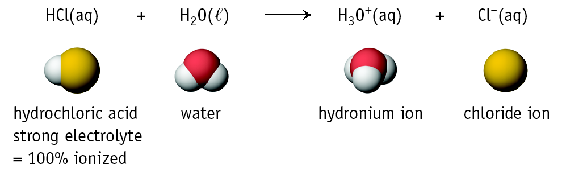
HONORS ONLY!
Strong and Weak Acids/Bases
The strength of an acid (or base) is determined by the amount of IONIZATION.
HNO₃, HCl, H₂SO₄ and HClO₄ are among the only known strong acids.

Slide 39
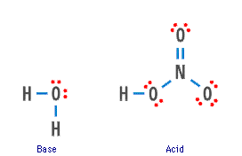
Strong and Weak Acids/Bases
HONORS ONLY!
Generally divide acids and bases into STRONG or WEAK ones.
STRONG ACID: HNO₃ (aq) + H₂O (l) ---> H₃O⁺ (aq) + NO₃⁻ (aq)
HNO₃ is about 100% dissociated in water.

Slide 40
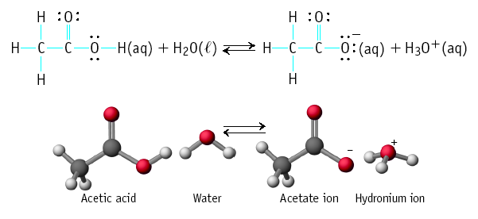
HONORS ONLY!
Strong and Weak Acids/Bases
Weak acids are much less than 100% ionized in water.
One of the best known is acetic acid = CH₃CO₂H

Slide 41
HONORS ONLY!
Strong and Weak Acids/Bases
Strong Base: 100% dissociated in water.
NaOH (aq) ---> Na⁺ (aq) + OH⁻ (aq)
Other common strong bases include KOH and Ca(OH)₂.
CaO (lime) + H₂O -->
Ca(OH)₂ (slaked lime)
CaO

Slide 42
HONORS ONLY!
Strong and Weak Acids/Bases
Weak base: less than 100% ionized in water
One of the best known weak bases is ammonia
NH₃ (aq) + H₂O (l) → NH₄⁺ (aq) + OH⁻ (aq)

Slide 43
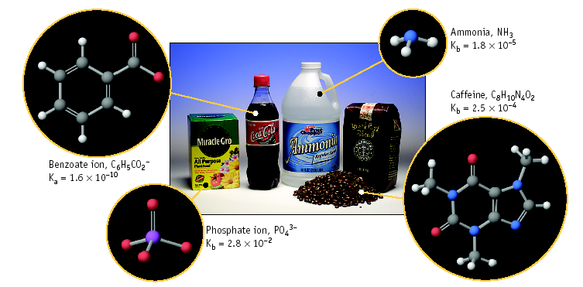
Weak Bases
HONORS ONLY!

Slide 44
Equilibria Involving
Weak Acids and Bases
HONORS ONLY!
Consider acetic acid, HC₂H₃O₂ (HOAc)
HC₂H₃O₂ + H₂O → H₃O⁺ + C₂H₃O₂ ⁻
Acid Conj. base
(K is designated K_{a} for ACID)
K gives the ratio of ions (split up) to molecules (don’t split up)

Slide 45
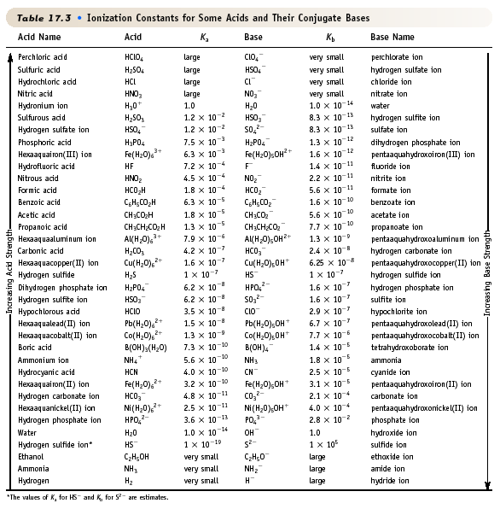
Ionization Constants for Acids/Bases
HONORS ONLY!
Acids
Conjugate
Bases
Increase strength
Increase strength

Slide 46
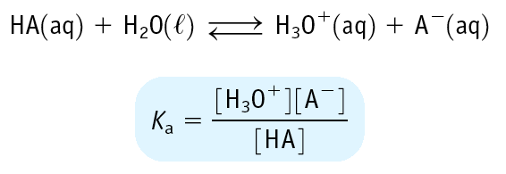
Equilibrium Constants for Weak Acids
HONORS ONLY!
Weak acid has K_{a} < 1
Leads to small [H₃O⁺] and a pH of 2 - 7

Slide 47
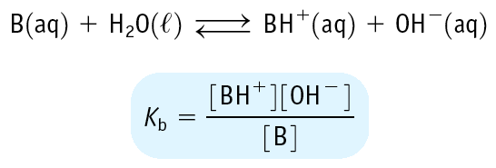
Equilibrium Constants for Weak Bases
HONORS ONLY!
Weak base has K_{b} < 1
Leads to small [OH⁻] and a pH of 12 - 7

Slide 48
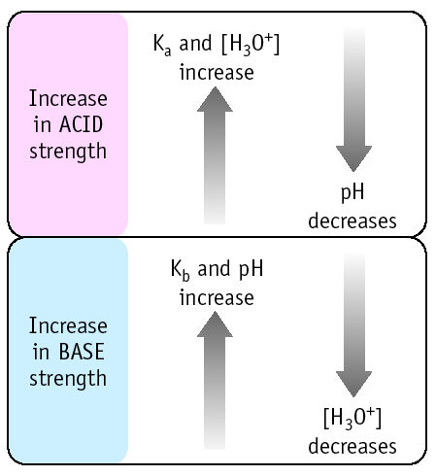
Relation of K_{a}, K_{b}, [H₃O⁺] and pH
HONORS ONLY!

Slide 49
Equilibria Involving A Weak Acid
HONORS ONLY!
You have 1.00 M HOAc. Calc. the equilibrium concs. of HOAc, H₃O⁺, OAc⁻, and the pH.
Step 1. Define equilibrium concs. in ICE table.
[HOAc] [H₃O⁺] [OAc⁻]
initial
change
equilib
1.00 0 0
-x +x +x
1.00-x x x

Slide 50
Equilibria Involving A Weak Acid
HONORS ONLY!
You have 1.00 M HOAc. Calc. the equilibrium concs. of HOAc, H₃O⁺, OAc⁻, and the pH.
Step 2. Write K_{a} expression
This is a quadratic. Solve using quadratic formula.
or you can make an approximation if x is very small! (Rule of thumb: 10⁻⁵ or smaller is ok)

Slide 51
Equilibria Involving A Weak Acid
HONORS ONLY!
You have 1.00 M HOAc. Calc. the equilibrium concs. of HOAc, H₃O⁺, OAc⁻, and the pH.
Step 3. Solve K_{a} expression
First assume x is very small because K_{a} is so small.
Now we can more easily solve this approximate expression.

Slide 52
Equilibria Involving A Weak Acid
HONORS ONLY!
You have 1.00 M HOAc. Calc. the equilibrium concs. of HOAc, H₃O⁺, OAc⁻, and the pH.
Step 3. Solve K_{a} approximate expression
x = [H₃O⁺] = [OAc⁻] = 4.2 x 10⁻³ M
pH = - log [H₃O⁺] = -log (4.2 x 10⁻³) = 2.37

Slide 53
Equilibria Involving A Weak Acid
HONORS ONLY!
Calculate the pH of a 0.0010 M solution of formic acid, HCO₂H.
HCO₂H + H₂O → HCO₂⁻ + H₃O⁺
K_{a} = 1.8 x 10⁻⁴
Approximate solution
[H₃O⁺] = 4.2 x 10⁻⁴ M, pH = 3.37
Exact Solution
[H₃O⁺] = [HCO₂⁻] = 3.4 x 10⁻⁴ M
[HCO₂H] = 0.0010 - 3.4 x 10⁻⁴ = 0.0007 M
pH = 3.47

Slide 54
Equilibria Involving A Weak Base
HONORS ONLY!
You have 0.010 M NH₃. Calc. the pH.
NH₃ + H₂O → NH₄⁺ + OH⁻
K_{b} = 1.8 x 10⁻⁵
Step 1. Define equilibrium concs. in ICE table
[NH₃] [NH₄⁺] [OH⁻]
initial
change
equilib
0.010 0 0
-x +x +x
0.010 - x x x

Slide 55
Equilibria Involving A Weak Base
HONORS ONLY!
You have 0.010 M NH₃. Calc. the pH.
NH₃ + H₂O → NH₄⁺ + OH⁻
K_{b} = 1.8 x 10⁻⁵
Step 1. Define equilibrium concs. in ICE table
[NH₃] [NH₄⁺] [OH⁻]
initial
change
equilib
0.010 0 0
-x +x +x
0.010 - x x x

Slide 56
Equilibria Involving A Weak Base
HONORS ONLY!
You have 0.010 M NH₃. Calc. the pH.
NH₃ + H₂O → NH₄⁺ + OH⁻
K_{b} = 1.8 x 10⁻⁵
Step 2. Solve the equilibrium expression
Assume x is small, so
x = [OH⁻] = [NH₄⁺] = 4.2 x 10⁻⁴ M
and [NH₃] = 0.010 - 4.2 x 10⁻⁴ ≈ 0.010 M
The approximation is valid !

Slide 57
Equilibria Involving A Weak Base
HONORS ONLY!
You have 0.010 M NH₃. Calc. the pH.
NH₃ + H₂O → NH₄⁺ + OH⁻
K_{b} = 1.8 x 10⁻⁵
Step 3. Calculate pH
[OH⁻] = 4.2 x 10⁻⁴ M
so pOH = - log [OH⁻] = 3.37
Because pH + pOH = 14,
pH = 10.63

Slide 58
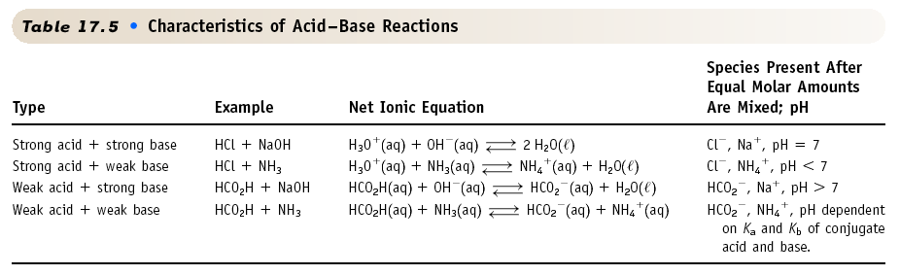
Types of Acid/Base Reactions: Summary
HONORS ONLY!

Slide 59
pH testing
There are several ways to test pH
  Blue litmus paper (red = acid)
  Red litmus paper (blue = basic)
  pH paper (multi-colored)
  pH meter (7 is neutral, <7 acid, >7 base)
  Universal indicator (multi-colored)
  Indicators like phenolphthalein
  Natural indicators like red cabbage, radishes

Slide 60
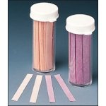
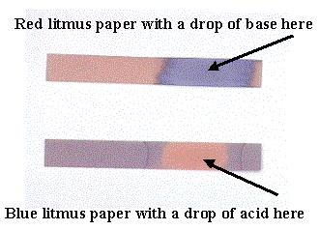
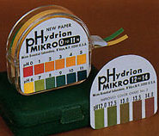
Paper testing
Paper tests like litmus paper and pH paper
  Put a stirring rod into the solution and stir.
  Take the stirring rod out, and place a drop of the solution from the end of the stirring rod onto a piece of the paper
  Read and record the color change. Note what the color indicates.
  You should only use a small portion of the paper. You can use one piece of paper for several tests.

Slide 61
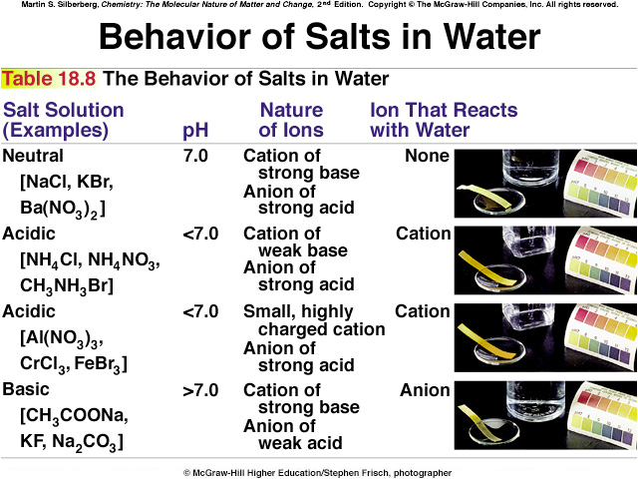
pH paper

Slide 62
pH meter
Tests the voltage of the electrolyte
Converts the voltage to pH
Very cheap, accurate
Must be calibrated with a buffer solution

Slide 63
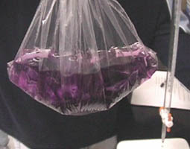
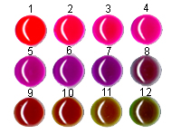

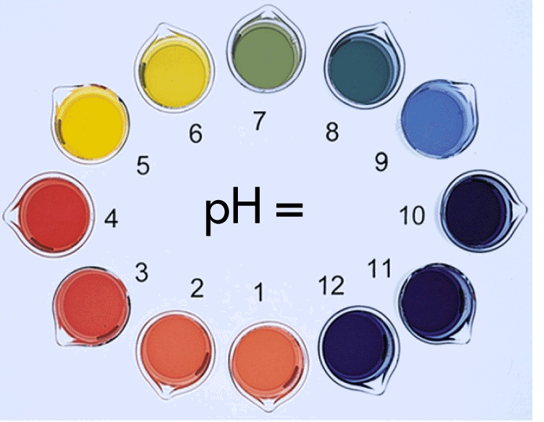
pH indicators
Indicators are dyes that can be added that will change color in the presence of an acid or base.
Some indicators only work in a specific range of pH
Once the drops are added, the sample is ruined
Some dyes are natural, like radish skin or red cabbage

Slide 64
ACID-BASE REACTIONS
Titrations
H₂C₂O₄(aq) + 2 NaOH(aq) --->
acid base
Na₂C₂O₄(aq) + 2 H₂O(liq)
Carry out this reaction using a TITRATION.
Oxalic acid,
H₂C₂O₄

Slide 65
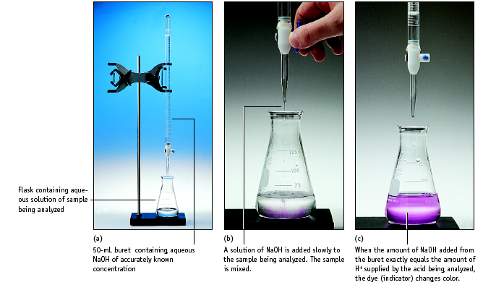
Setup for titrating an acid with a base

Slide 66
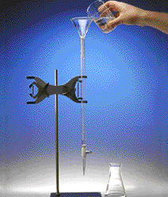
Titration
1. Add solution from the buret.
2. Reagent (base) reacts with compound (acid) in solution in the flask.
Indicator shows when exact stoichiometric reaction has occurred. (Acid = Base)
This is called NEUTRALIZATION.

Slide 67
LAB PROBLEM #1: Standardize a solution of NaOH — i.e., accurately determine its concentration.
35.62 mL of NaOH is neutralized with 25.2 mL of 0.0998 M HCl by titration to an equivalence point. What is the concentration of the NaOH?

Slide 68
PROBLEM: You have 50.0 mL of 3.0 M NaOH and you want 0.50 M NaOH. What do you do?
Add water to the 3.0 M solution to lower its concentration to 0.50 M
Dilute the solution!

Slide 69
PROBLEM: You have 50.0 mL of 3.0 M NaOH and you want 0.50 M NaOH. What do you do?
But how much water
do we add?

Slide 70
PROBLEM: You have 50.0 mL of 3.0 M NaOH and you want 0.50 M NaOH. What do you do?
How much water is added?
The important point is that --->
moles of NaOH in ORIGINAL solution =
moles of NaOH in FINAL solution

Slide 71
PROBLEM: You have 50.0 mL of 3.0 M NaOH and you want 0.50 M NaOH. What do you do?
Amount of NaOH in original solution =
M • V =
(3.0 mol/L)(0.050 L) = 0.15 mol NaOH
Amount of NaOH in final solution must also = 0.15 mol NaOH
Volume of final solution =
(0.15 mol NaOH) / (0.50 M) = 0.30 L
or 300 mL

Slide 72
PROBLEM: You have 50.0 mL of 3.0 M NaOH and you want 0.50 M NaOH. What do you do?
Conclusion:
add 250 mL of water to 50.0 mL of 3.0 M NaOH to make 300 mL of 0.50 M NaOH.

Slide 73
Preparing Solutions by Dilution
A shortcut
M₁ • V₁ = M₂ • V₂

Slide 74
You try this dilution problem
You have a stock bottle of hydrochloric acid, which is 12.1 M. You need 400 mL of 0.10 M HCl. How much of the acid and how much water will you need?

