Slide 1
Circulatory System
By: Brittany Martinez, Josue Garcia, and Charles Carr

Slide 2
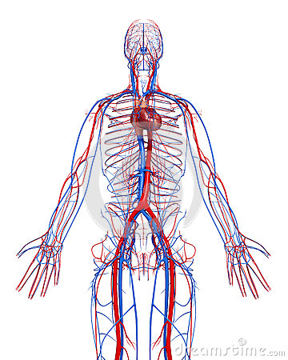
Major Functions
The Circulatory System is responsible for transporting materials to and from cells and nutrients throughout the entire body.

Slide 3
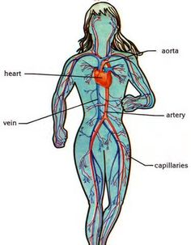
Artery:
A route for the blood to travel.
Vein:
A vessel that transports blood to the heart.
Capillary:
The smallest blood vessel, it connects the artery to the vein.
Heart:
Pumps blood to the lungs and body systems.

Slide 4
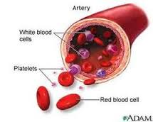
Describing Components Of Blood
Plasma
Contains proteins to help blood to clot, contains glucose and other dissolved nutrients
Platelets
Help in blood clotting
Ex. Platelets are responsible for creating scabs
White Blood Cells
Help fight infections and help in immune process
Red Blood Cell
Carry oxygen from the lungs to the rest of the body

Slide 5
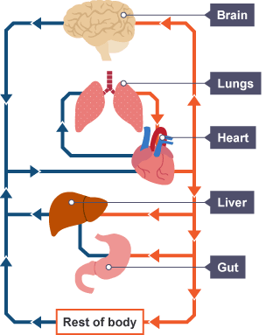
Path Blood Travels Through Body
The oxygen you breathe in the air passes through your lungs into you blood through your many capillaries in the lungs oxygen rich blood moves through your pulmonary veins to the left side of your heart and out of the aorta to the rest of your body

Slide 6
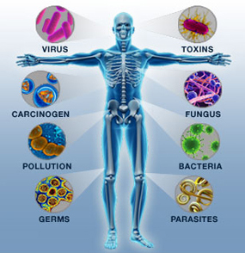
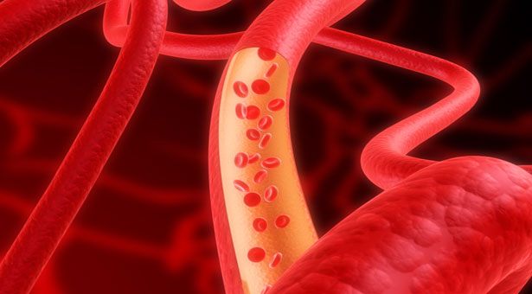
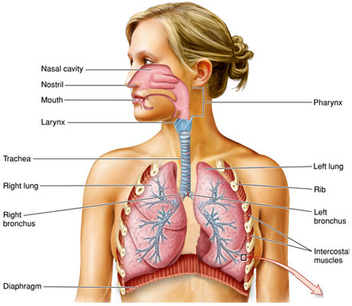
How the Circulatory System Works with Other Body Systems
Immune System:
The immune system is made up of white blood cells and antibodies. These cells travel in blood and fight infections/invasions
Digestive System:
When food is broken down, needed nutrients are put in bloodstream for the cells to use the energy
Respiratory System:
Brings oxygen into the body. Entering through the lungs into the alveoli, and sent through blood vessels into the bloodstream

Slide 7
Fun Fact Questions
1. How long are all the arteries, capillaries and veins in one adult(end to end)?
2. How big are capillaries?
3. What is an average resting heart rate of an adult human?
4. What do red blood cells lack?
5. How many times does a average person’s heartbeat in a life span?

Slide 8
Fun Fact Answers
1. How long are all the arteries, capillaries and veins in one adult from end to end?
60,000 Miles!!!!!!!!!!!!
2. How big are capillaries?
8 microns or 1/3000 inch!!!!!!!!!!!!
3. What is an average resting heart rate of an adult human?
75 Beats per minute!!!!!
4. What do red blood cells lack?
A nucleus!!!!!!!
5. How many times does a average person’s heartbeat in a life span?
3 billion times!!!!!!!!!

