Slide 1
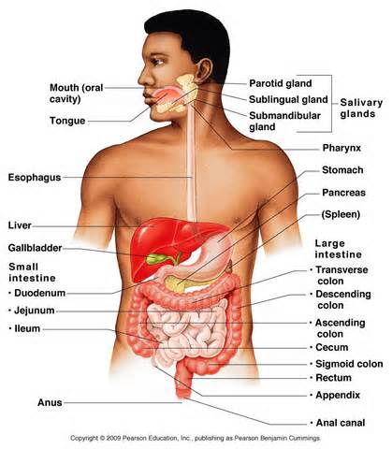
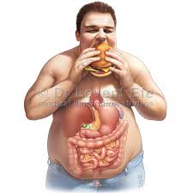
Digestive System

Slide 2
MAJOR FUNCTIONS
The major functions of the digestive system are:
pharynx
Esophagus
Stomach
Small intestine( small bowel)
Large intestine (colon)
Rectum

Slide 3
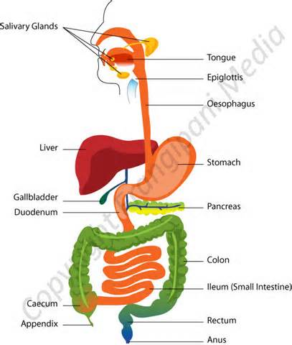
What do the major functions do?
The pharynx : also known as the throat portion of the digestive system tract that receives the food from your mouth.
Esophagus : carries food through the stomach and the trachea or windpipe which carries air to the lungs.
Stomach : breaks down food and digest food in order to extract necessary nutrients from what you’ve eaten.
Small Intestine : 90% of the digestion and absorption of food occurs here.
Large Intestine : Absorbs food or water from the remaining indigestible food matter and transmits the useless waste material from the body.
Rectum : Is the concluding part of the large intestine that terminates in the anus.
Pancreas: Is converting the food we eat into fuel for the body's cells.
Liver: Plays a major role in the metabolism of the body it also discomposes red blood cells, and the regulation of glycogen.

Slide 4
Path Food Travels Through
Step 1: Mouth/Pharynx mechanical breakdown of food by chewing and chemical breakdown through saliva
Step 2: Esophagus food moves towards stomach by peristaltic movements.
Step 3: Mainly breakdown of food
Step 4: Small Intestine digestion of starches and absorption of some nutrients.
Step 5: Large Intestine absorption of water and salt concentration of feces.
Step 6: Appendix dead end of the cecum, some bacterial action produces vitamin K and continues to digest.
Step 7: Rectum- feces( undigested material and bacteria)
Step 8: Anus- waste leaved the body and digestive system

Slide 5
How the Digestive System Interacts with other Systems
The digestive system interacts with the excretory system it removes un-digestive food through urine and feces.
It also interacts with the respiratory system because the mouth is used to breath.
It also works with the muscular system the muscles help push the food through the intestines with contractions.

Slide 6
Fun Facts ☺
The stomach of an adult holds 1.5 liters of food and stays there for 2 to 3 hours.
The large intestine is about 5 feet in length.
We make 1 to 3 pints of saliva a day.
The liver is the largest organ in our body and has more than 500 functions.
We eat about 500kg of food per year.

Slide 7
Cracker Time
Materials: Everyday crackers (2 per student)
This demonstration shows how your saliva a) works to break apart the bonds holding the cracker together and b) mixes with the food to produce a swallow material.
Step 1 – Put a regular cracker into your mouth and chew. Record what it tastes like? Was it sweet? Plain? Hard? Soft? Etc.
Step 2 – Place a new cracker in your mouth and let it sit for 1.5 minutes before chewing and answer the following questions (number 2 should be answered at the 1 minute mark).
Observations – 1) What does it feel like initially? 2) What is feels like after 1 minutes in your mouth 3) What it feels like after 1.5 minutes in your mouth 4) What it feels like when you chew it?

Slide 8
Flor Zenteno
Daniella Garcia
Enrique Avila
Etzu Foster

