Slide 1
Excretory system

Slide 2
Major functions
Removes excess, unnecessary materials from the body fluids of an organism, so as to help maintain internal chemical homeostasis and prevent damage to the body

Slide 3
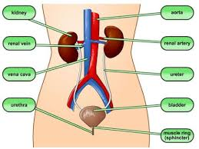
Excretory diagram

Slide 4
How it works with circulatory system
The circulatory system interacts with the Excretory system by cycling the blood through the kidneys in which they remove waste and unnecessary materials. The materials are then put through its course of the excretory system.

Slide 5
How it works with the digestive system
The digestive system takes the energy from food, and then takes the wastes and extra material, and takes those materials and sends them through the intestines.

Slide 6
Facts about the excretory system
The average person’s intestines span 27 feet when laid out in a line.
The bladder can hold up to 24 ounces of liquid. That’s like two cans of soda.
The average person poops about 305 pounds each year.
The average person will also pee 3,000 times per year.
The liver is rubbery to the touch. Who knew?!

Slide 7
Cited sources
http://excretorysystemmiguel.weebly.com/fun-facts.html

Slide 8
Credits
The blood sweat and tears was brought to you by the awesome the cool the brilliant the master minds of:
Carolina R. Melany R.
Cristian M.
Destin B.
Giovanni J.
Jonathan R.

