Slide 1
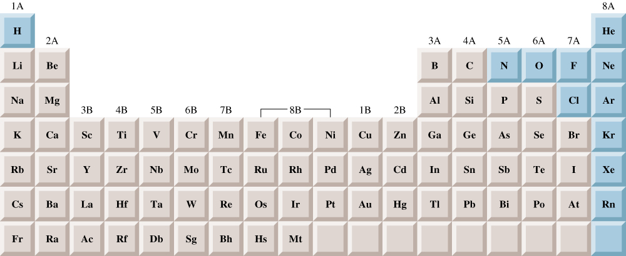
Elements that exist as gases at 25⁰C and 1 atmosphere

Slide 2
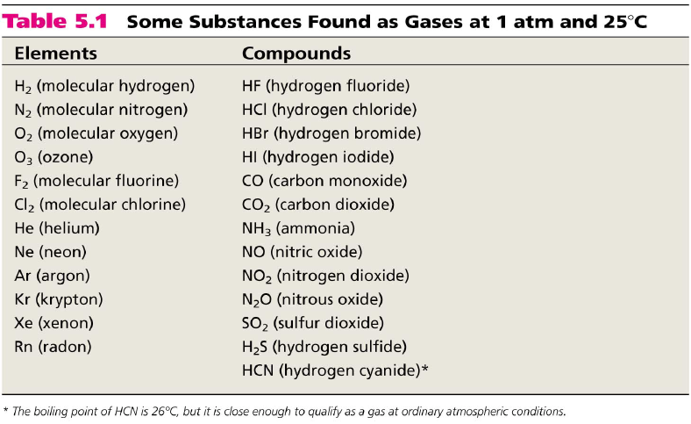

Slide 3
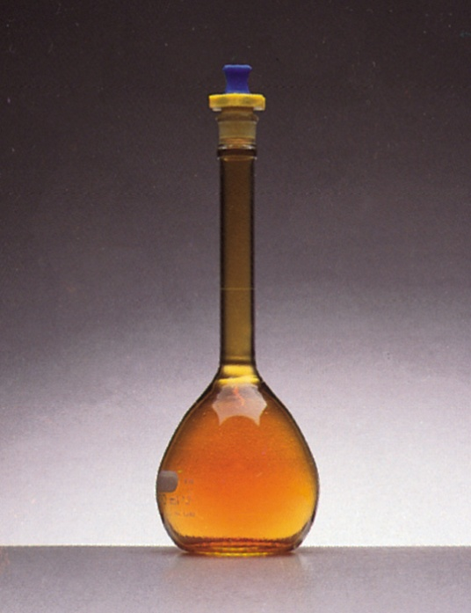
Physical Characteristics of Gases
Gases assume the volume and shape of their containers.
Gases are the most compressible state of matter.
Gases will mix evenly and completely when confined to the same container.
Gases have much lower densities than liquids and solids.

Slide 4
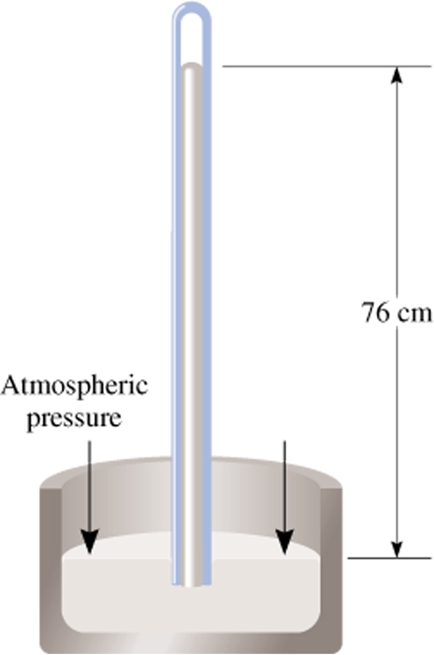
Force
Pressure =
Area
Units of Pressure
1 pascal (Pa) = 1 N/m²
1 atm = 760 mmHg = 760 torr
1 atm = 101,325 Pa
Barometer

Slide 5
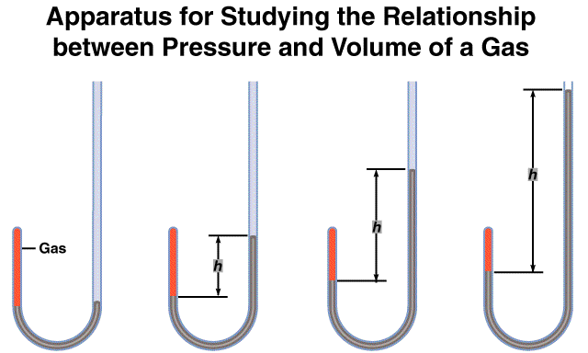
As P (h) increases
V decreases

Slide 6
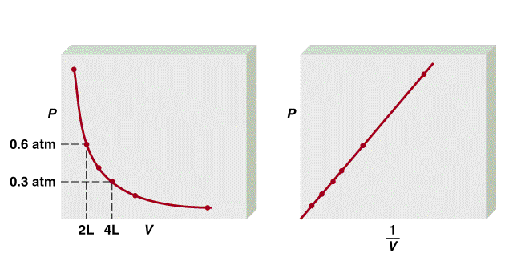
Boyle’s Law
P α 1/V
Constant temperature
Constant amount of gas
P x V = constant
P₁ x V₁ = P₂ x V₂

Slide 7
A sample of chlorine gas occupies a volume of 946 mL at a pressure of 726 mmHg. What is the pressure of the gas (in mmHg) if the volume is reduced at constant temperature to 154 mL?
P₁ x V₁ = P₂ x V₂
P₁ = 726 mmHg
P₂ = ?
V₁ = 946 mL
V₂ = 154 mL
P₁ x V₁
726 mmHg x 946 mL
P₂ =
=
= 4460 mmHg
V₂
154 mL

Slide 8
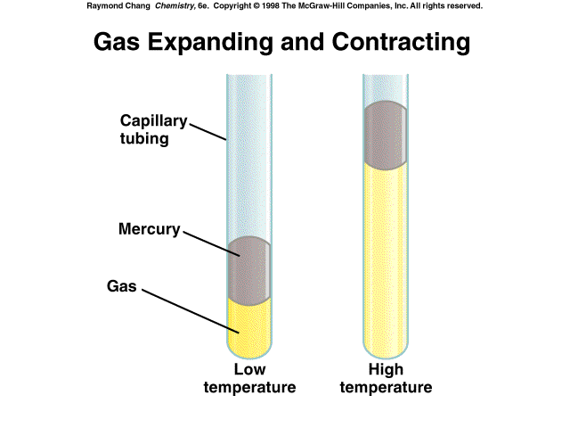
As T increases
V increases

Slide 9
A sample of carbon monoxide gas occupies 3.20 L at 125 ⁰C. At what temperature will the gas occupy a volume of 1.54 L if the pressure remains constant?
V₁/T₁ = V₂/T₂
V₁ = 3.20 L
V₂ = 1.54 L
T₁ = 398.15 K
T₂ = ?
V₂ x T₁
1.54 L x 398.15 K
T₂ =
=
= 192 K
V₁
3.20 L

Slide 10
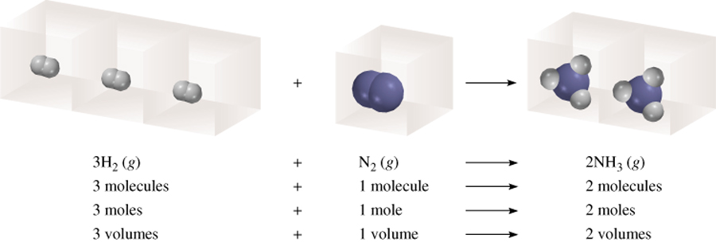
Avogadro’s Law
V α number of moles (n)
Constant temperature
Constant pressure
V = constant x n
V₁/n₁ = V₂/n₂

Slide 11
Ideal Gas Equation
1
Boyle’s law: V α (at constant n and T)
P
Charles’ law: V α T (at constant n and P)
Avogadro’s law: V α n (at constant P and T)
nT
V α
P
nT
nT
V = constant x = R
R is the gas constant
P
P
PV = nRT

Slide 12
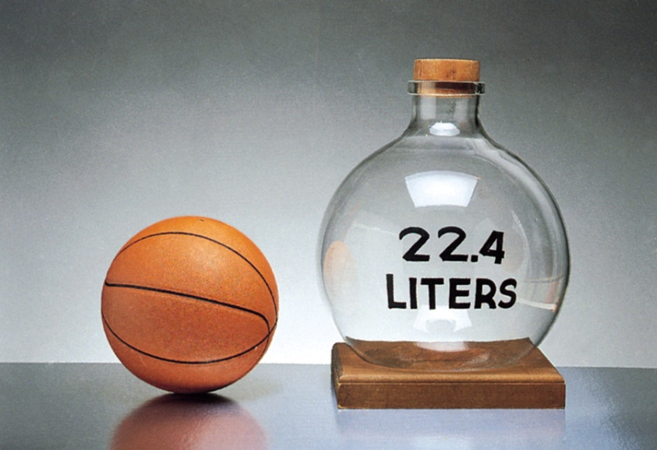
The conditions 0 ⁰C and 1 atm are called standard temperature and pressure (STP).
Experiments show that at STP, 1 mole of an ideal gas occupies 22.414 L.
PV = nRT
PV
(1 atm)(22.414L)
R =
=
nT
(1 mol)(273.15 K)
R = 0.082057 L • atm / (mol • K)

Slide 13
What is the volume (in liters) occupied by 49.8 g of HCl at STP?
T = 0 ⁰C = 273.15 K
P = 1 atm
PV = nRT
1 mol HCl
nRT
n = 49.8 g x
= 1.37 mol
V =
36.45 g HCl
P
L•atm
1.37 mol x 0.0821 x 273.15 K
mol•K
V =
1 atm
V = 30.6 L

Slide 14
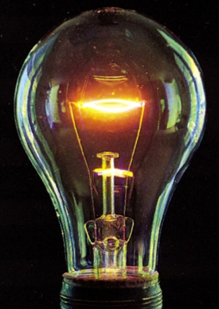
Argon is an inert gas used in lightbulbs to retard the vaporization of the filament. A certain lightbulb containing argon at 1.20 atm and 18 ⁰C is heated to 85 ⁰C at constant volume. What is the final pressure of argon in the lightbulb (in atm)?
PV = nRT
n, V and R are constant
nR
P
=
= constant
P₁ = 1.20 atm
P₂ = ?
V
T
T₁ = 291 K
T₂ = 358 K
P₁
P₂
=
T₁
T₂
T₂
358 K
P₂ = P₁ x
= 1.20 atm x
= 1.48 atm
T₁
291 K

Slide 15
Density (d) Calculations
PM
m is the mass of the gas in g
m
d =
=
V
RT
M is the molar mass of the gas
Molar Mass (M ) of a Gaseous Substance
dRT
M =
d is the density of the gas in g/L
P

Slide 16
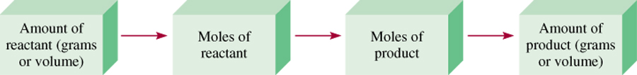
Gas Stoichiometry
What is the volume of CO₂ produced at 37⁰ C and 1.00 atm when 5.60 g of glucose are used up in the reaction:
C₆H₁₂O₆ (s) + 6O₂ (g) 6CO₂ (g) + 6H₂O (l)
g C₆H₁₂O₆ mol C₆H₁₂O₆ mol CO₂ V CO₂
1 mol C₆H₁₂O₆
6 mol CO₂
5.60 g C₆H₁₂O₆
x
x
= 0.187 mol CO₂
180 g C₆H₁₂O₆
1 mol C₆H₁₂O₆
L•atm
0.187 mol x 0.0821 x 310.15 K
nRT
mol•K
V =
=
= 4.76 L
P
1.00 atm

Slide 17
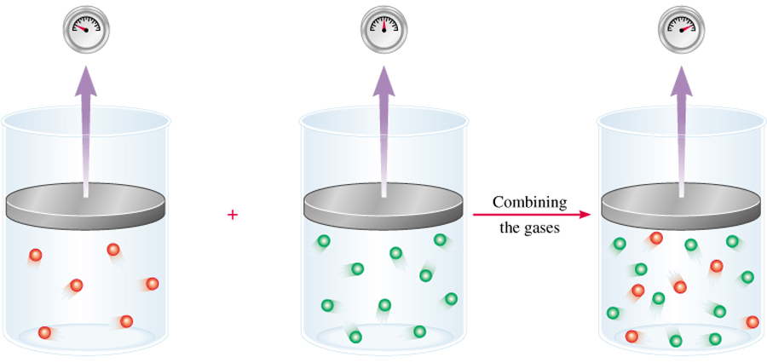
Dalton’s Law of Partial Pressures
V and T are constant
P₁
P₂
P_{total} = P₁ + P₂

Slide 18
Kinetic Molecular Theory of Gases
A gas is composed of molecules that are separated from each other by distances far greater than their own dimensions. The molecules can be considered to be points; that is, they possess mass but have negligible volume.
Gas molecules are in constant motion in random directions. Collisions among molecules are perfectly elastic.
Gas molecules exert neither attractive nor repulsive forces on one another.
The average kinetic energy of the molecules is proportional to the temperature of the gas in kelvins. Any two gases at the same temperature will have the same average kinetic energy

Slide 19
Kinetic theory of gases and …
Compressibility of Gases
Boyle’s Law
    P α collision rate with wall
    Collision rate α number density
    Number density α 1/V
    P α 1/V
Charles’ Law
    P α collision rate with wall
    Collision rate α average kinetic energy of gas molecules
    Average kinetic energy α T
    P α T

Slide 20
Kinetic theory of gases and …
Avogadro’s Law
    P α collision rate with wall
    Collision rate α number density
    Number density α n
    P α n
Dalton’s Law of Partial Pressures
    Molecules do not attract or repel one another
    P exerted by one type of molecule is unaffected by the presence of another gas
    P_{total} = ΣP_{i}

