Slide 1
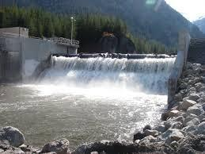
Hydroelectric
By Marisol Avelar
Valeria Ledezma

Slide 2
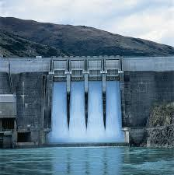
Bell ringer
Draw a hydropower plant and label.

Slide 3
https://www.youtube.com/watch?v=wvxUZF4lvGw

Slide 4
Hydro power is…
Any technology that uses the kinetic energy of flowing and falling water to produced electricity.

Slide 5
Advantages
We can use water flowing over dams, tidal flows, and ocean waves to generate electricity.
It has a high net energy yield.
Low cost electricity.
Large untapped potential.
Low air pollution and low emission of Co2.

Slide 6
Disadvantages
Limited availability of suitable sites may limit the use of these energy sources.
Large land disturbance and displacement of people
High CH4 emissions from rapid biomass decay in shallow topical reservoirs
Disrupts downstream aquatic ecosystem

Slide 7
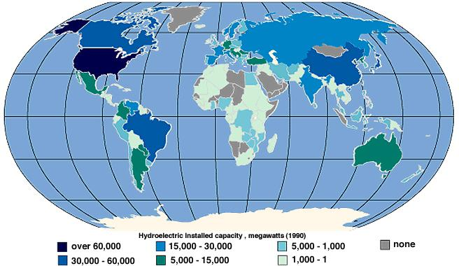
How we use it
The leading renewable energy source, produces about 16% of the worlds electricity in 150 countries.
The worlds top 4 consumers are China, Canada, Brazil, and the United States.

Slide 8
Some Facts…
Water is a renewable energy source due to the hydrologic or water cycle.
Hydropower plants usually include dams across rivers to hold back water in reservoirs.
stored water is released to flow through turbines, spinning generators to produce electricity.
energy in the oceans’ waves and tides can be harnessed to produce electrical power
Moving water is a safe, clean, and economical energy source.

Slide 9
Energy consumption

Slide 10
Energy 101: Hydropower
http://www.youtube.com/watch?v=tpigNNTQix8&edufilter=RfShgCQsr4Pr_FPU-fP5ZA&safe=active

Slide 11
Uses of Dams

Slide 12
Ticket Out
1.What percentage of hydroelectricity comes from dams?
2.What are the top 4 countries that use hydroelectricity?
3. Name and EXPLAIN 3 things you learned today and why they are important.
4.Is using hydroelectricity worth it?

