Slide 1
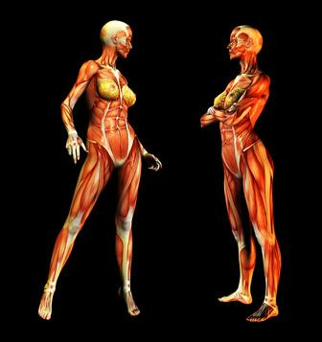
Muscular System
By Karla, Yuliana, Sara, Maryalex .

Slide 2
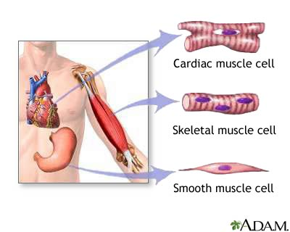
Major functions cardiac muscle, smooth muscle, skeletal muscle.

Slide 3
Function and locations
Cardiac muscle : it helps to pump the heart, help move material through the digestive tract, and moves the body.
Skeletal muscle : voluntary muscle that is usually attached to the bone and helps us to move.
Smooth muscle : involuntary muscle found in the walls of hollow organs.

Slide 4
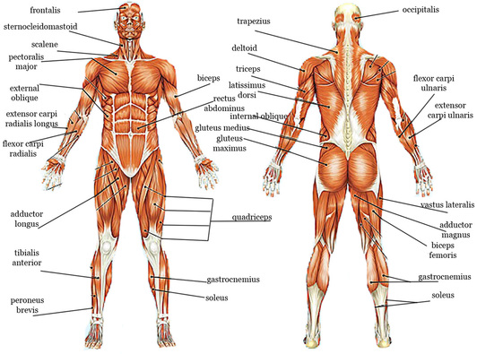
Muscular system diagram

Slide 5
Biceps and triceps
Muscle work in pairs just like the biceps and the triceps muscle does one job like lifting your arms in the biceps job, while lowering your arms is the triceps cobwebbed these two muscle.

Slide 6
How our muscular system works with other systems?
The muscular system requires nervous stimulation from the brain and nerves to create the electrical impulses that move the muscles.
Muscles require support from bones to support themselves and allow you to move to move in lots of different directions
The heart muscle drives the blood in the circulatory system.

Slide 7
Facts about the muscular system
Muscles make up to 40% of your total body weight.
Takes half as long to gain muscle than it does to lose it .
Your tongue is the strongest muscle in your body.
The smallest muscle are found in the middle ear.
To take one step , you use 200 muscles.

