Slide 1
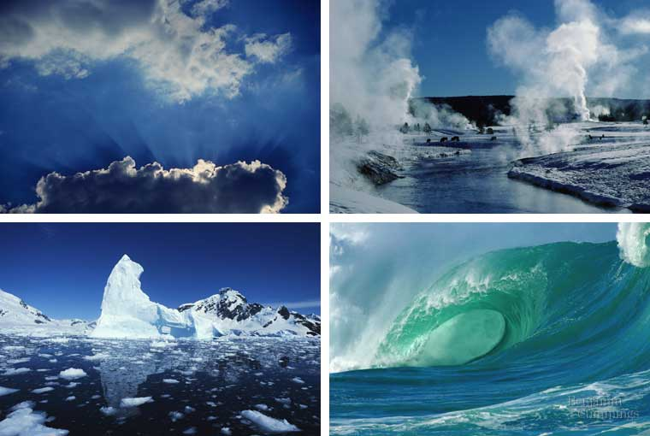
Water

Slide 2
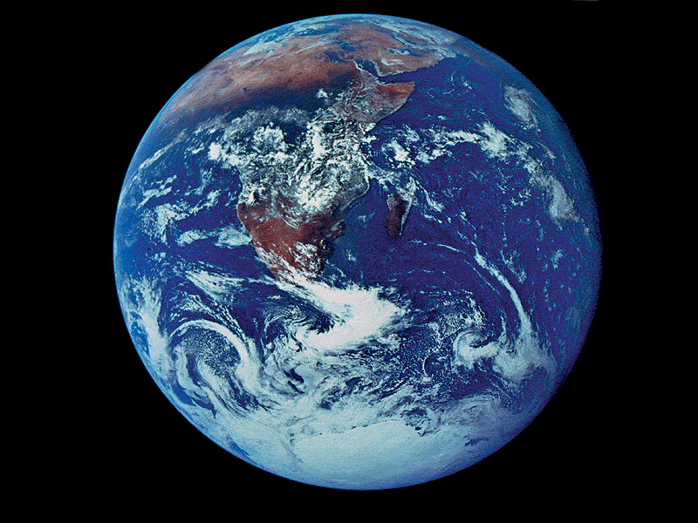
Properties of Water
Polar molecule
Cohesion and adhesion
High specific heat
Density – greatest at 4ºC
Universal solvent of life

Slide 3
Polarity of Water
In a water molecule two hydrogen atoms form single polar covalent bonds with an oxygen atom. Gives water more structure than other liquids
Because oxygen is more electronegative, the region around oxygen has a partial negative charge.
The region near the two hydrogen atoms has a partial positive charge.
A water molecule is a polar molecule with opposite ends of the molecule with opposite charges.
Notes:
2 corners are orbitals with unshared electrons and a weak negative charge
2 are occupied by hydrogen atoms that have polar covalent bonds

Slide 4
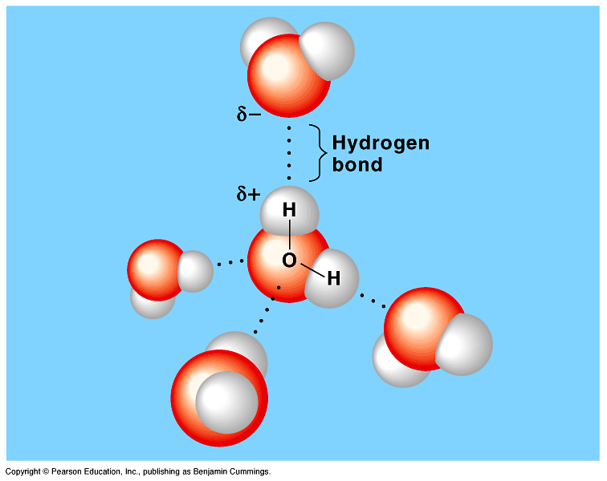
Water has a variety of unusual properties because of attractions between these polar molecules.
The slightly negative regions of one molecule are attracted to the slightly positive regions of nearby molecules, forming a hydrogen bond.
Each water molecule can form hydrogen bonds with up to four neighbors.
Fig. 3.1
Copyright © 2002 Pearson Education, Inc., publishing as Benjamin Cummings

Slide 5
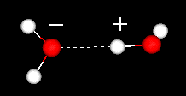
HYDROGEN BONDS
Hold water molecules together
Each water molecule can form a maximum of 4 hydrogen bonds
The hydrogen bonds joining water molecules are weak, about 1/20th as strong as covalent bonds.
They form, break, and reform with great frequency
Extraordinary Properties that are a result of hydrogen bonds.
Cohesive behavior
Resists changes in temperature
High heat of vaporization
Expands when it freezes
Versatile solvent

Slide 6
Organisms Depend on Cohesion
Hydrogen bonds hold the substance together, a phenomenon called cohesion
Cohesion is responsible for the transport of the water column in plants
Cohesion among water molecules plays a key role in the transport of water against gravity in plants
Adhesion, clinging of one substance to another, contributes too, as water adheres to the wall of the vessels.

Slide 7
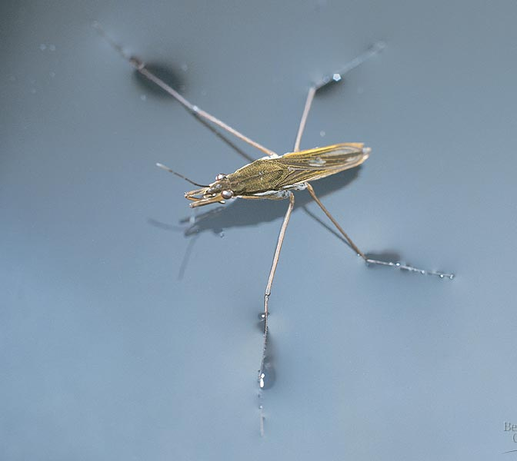
Surface tension, a measure of the force necessary to stretch or break the surface of a liquid, is related to cohesion.
Water has a greater surface tension than most other liquids because hydrogen bonds among surface water molecules resist stretching or breaking the surface.
Water behaves as if covered by an invisible film.
Some animals can stand, walk, or run on water without breaking the surface.
Fig. 3.3
Copyright © 2002 Pearson Education, Inc., publishing as Benjamin Cummings

Slide 8
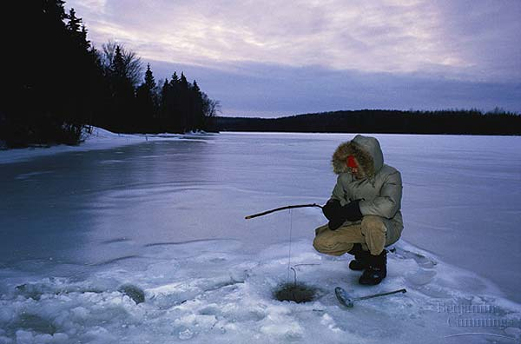
Specific Heat is the amount of heat that must be absorbed or lost for one gram of a substance to change its temperature by 1ºC.
Three-fourths of the earth is covered by water. The water serves as a large heat sink responsible for:
Prevention of temperature fluctuations that are outside the range suitable for life.
Coastal areas having a mild climate
A stable marine environment

Slide 9
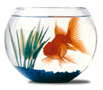
Evaporative Cooling
The cooling of a surface occurs when the liquid evaporates
This is responsible for:
Moderating earth’s climate
Stabilizes temperature in aquatic ecosystems
Preventing organisms from overheating

Slide 10
Density of Water
Most dense at 4ºC
Contracts until 4ºC
Expands from 4ºC to 0ºC
The density of water:
Prevents water from freezing from the bottom up.
Ice forms on the surface first—the freezing of the water releases heat to the water below creating insulation.
Makes transition between season less abrupt.

Slide 11
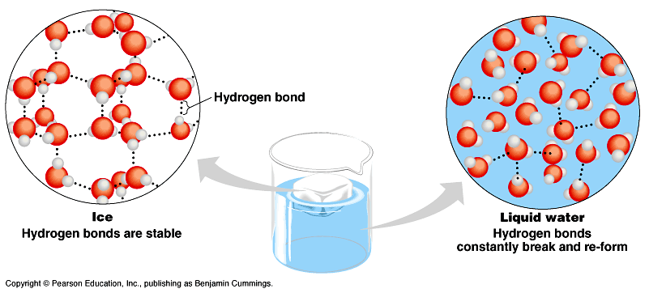
When water reaches 0ºC, water becomes locked into a crystalline lattice with each molecule bonded to to the maximum of four partners.
As ice starts to melt, some of the hydrogen bonds break and some water molecules can slip closer together than they can while in the ice state.
Ice is about 10% less dense than water at 4ºC.
Fig. 3.5
Copyright © 2002 Pearson Education, Inc., publishing as Benjamin Cummings

Slide 12
Solvent for Life
Solution
Solute
solvent
Aqueous solution
Hydrophilic
Ionic compounds dissolve in water
Polar molecules (generally) are water soluble
Hydrophobic
Nonpolar compounds

Slide 13
Water: the Universal Solvent
One side of water is negatively charged because the oxygen atom keeps the shared electrons longer than the hydrogen atoms. As a result the oxygen side is negatively charged and the hydrogen side of water is positively charged.
O

Slide 14
Water: the Universal Solvent
Like a magnet that pulls on things that are magnetic, water pulls on things that are electrically charged. Magnets have north & south poles, water has positive and negative poles and thus called a polar solvent.
Since unlike charges attract, the negative end of water will be attracted to the positive sodium ion. The positive end of water will be attracted to the negative chloride ion.
Since water is always in motion, it will pull on the ionic compound and move the ions away from each other. This dissolves the ionic compound.
O
O
Na⁺
Cl⁻
O
O
O
The motion paths with some spin effects are good ways to show this concept.

Slide 15
Wax does not repel water
We’ve heard that wax or oils repel water. But that isn’t true. Water is so attracted to other water molecules that anything between them is squeezed out of the way.
O
Oil droplet
O
Simple motion paths with some spin makes this concept easier to understand.
O
O
O

