Slide 1
Respiratory System
Alondra Huerta
Christian Oropeza
Diego Servin
Brenda Rodriguez
Period 3

Slide 2
Major Functions of the system:
The respiratory system provides oxygen to the body’s cells while removing carbon dioxide.
The major parts of the respiratory system are: trachea, lungs, diaphragm, epiglottis, larynx, and vocal cords
3 major parts: the airway, lungs, and muscles of respiration.

Slide 3
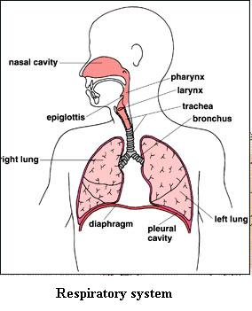
Major parts:
Trachea- connects the larynx to the bronchi and allows air to pass through the neck and into the thorax.
Lungs- help get oxygen into the red blood cells which carry oxygen around the body. They also help get rid of CO2.
Diaphragm- the muscle that separates the chest from the abdomen. It expands the lungs during respiration when we breath air in.

Slide 4
Major Parts (continuation):
Epiglottis- when swallowing food, the epiglottis folds over to stop liquid and food from entering the trachea.
Larynx- It is the part of the throat that keeps food and drinks out of the airways during swallowing.
Vocal cords-they are composed of twin enfolding's of mucous membrane that vibrate, modulating the flow of air being expelled from the lungs during phonation.

Slide 5
“Breathing Process”
When you breathe in, or inhale, your diaphragm contracts (tightens) and moves downward. This increases the space in your chest cavity, into which your lungs expand. The intercostal muscles between your ribs also help enlarge the chest cavity. They contract to pull your rib cage both upward and outward when you inhale.

Slide 6
Respiratory & how it works with other systems:
Skeletal System- Helps the respiratory system by protecting the lungs.
Digestive System- breaks down food into simpler substances that the body can use. This helps the respiratory because it needs its nutrients.
Muscular- helps push air come into and leave the respiratory system through the contraction and relaxation of the diaphragm.

Slide 7
Fun Facts:
New born’s normal breathing rate is 40 times each minute.
Adults average respiratory rate is 12 to 16 breaths per minute.
Several diseases and other bad conditions can be caused by inhaling things such as chemicals, cigarette smoke and allergens.
Modeling studies have estimated the velocity of a sneeze at 112 mph.
If you don’t have oxygen, and you cant get rid of carbon dioxide, your body cant live for longer than a few minutes.

