Slide 1
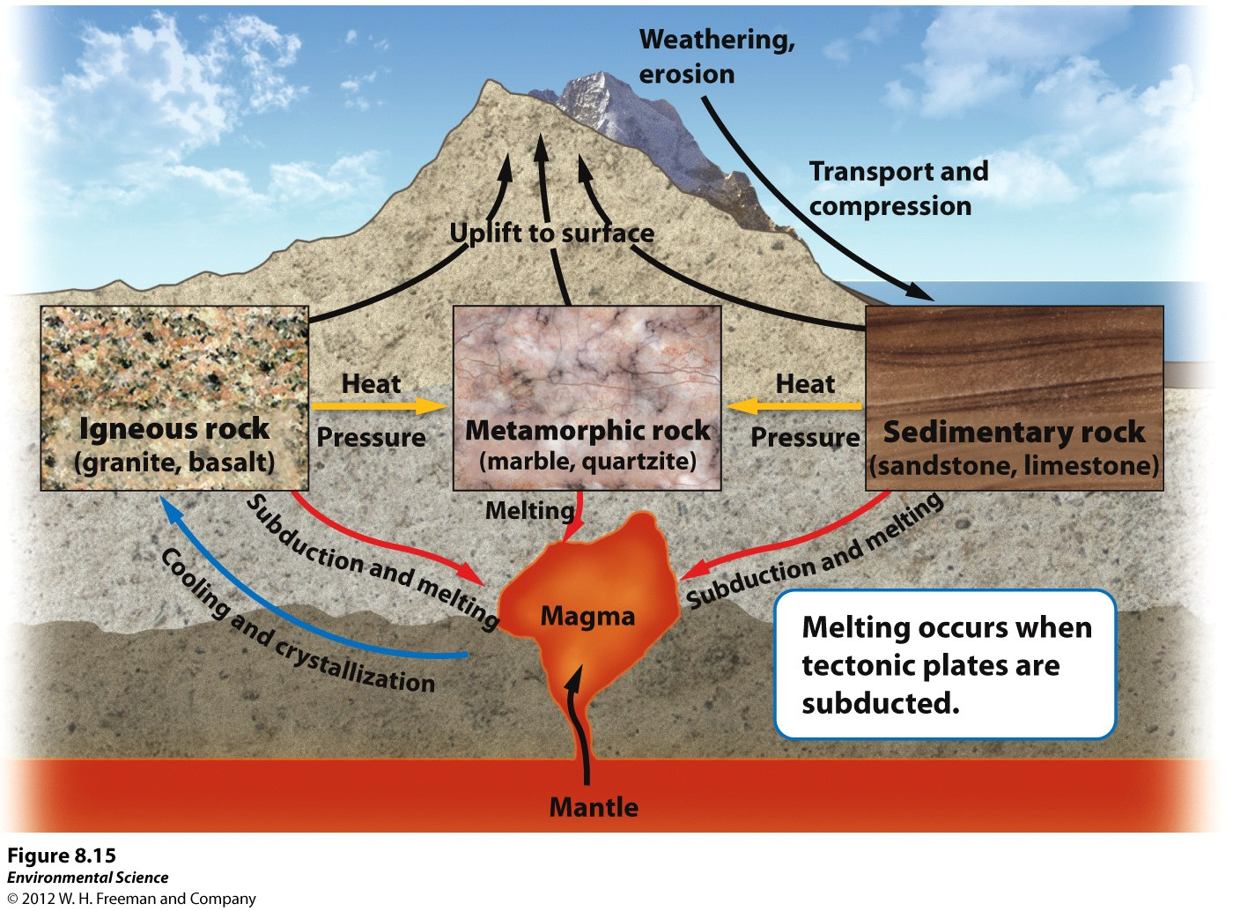
The Rock Cycle
Rock cycle- the constant formation and destruction of rock.

Slide 2
The Rock Cycle
Igneous rocks- rocks that form directly from magma.
Intrusive igneous- form from within Earth as magma cools.
Extrusive igneous- from when magma cools above Earth. (ex. A volcano that ejects magma out will form this)
Sedimentary rocks- form when sediment such as mud, sands, or gravels are compressed by overlying sediments.
Metamorphic rocks- form when sedimentary, igneous or other metamorphic rocks are subjected to high temperatures and pressures.

Slide 3
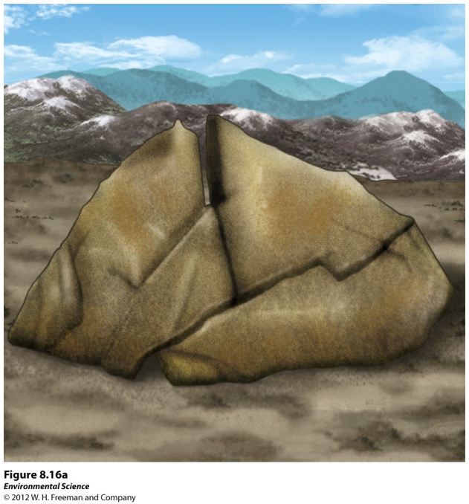
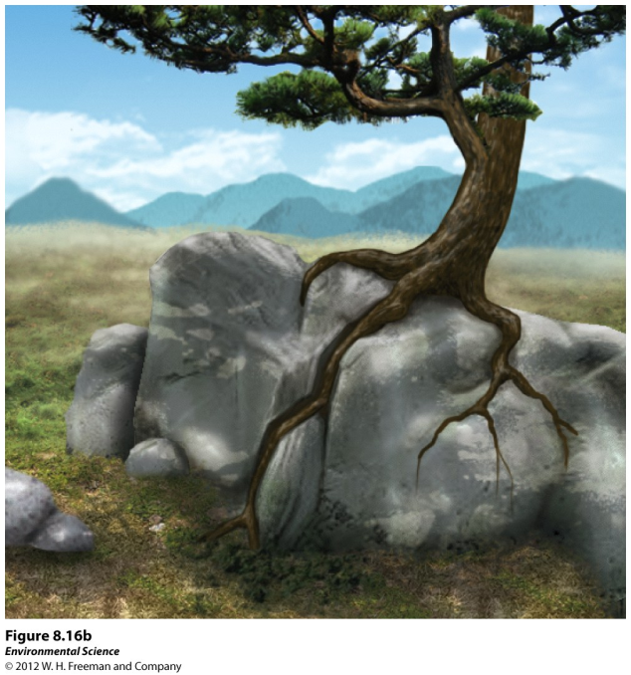
Weathering and Erosion
Weathering- when rocks are exposed to air, water, certain chemicals or biological agents that degrade the rock.
Physical weathering- the mechanical breakdown of rocks and minerals.

Slide 4
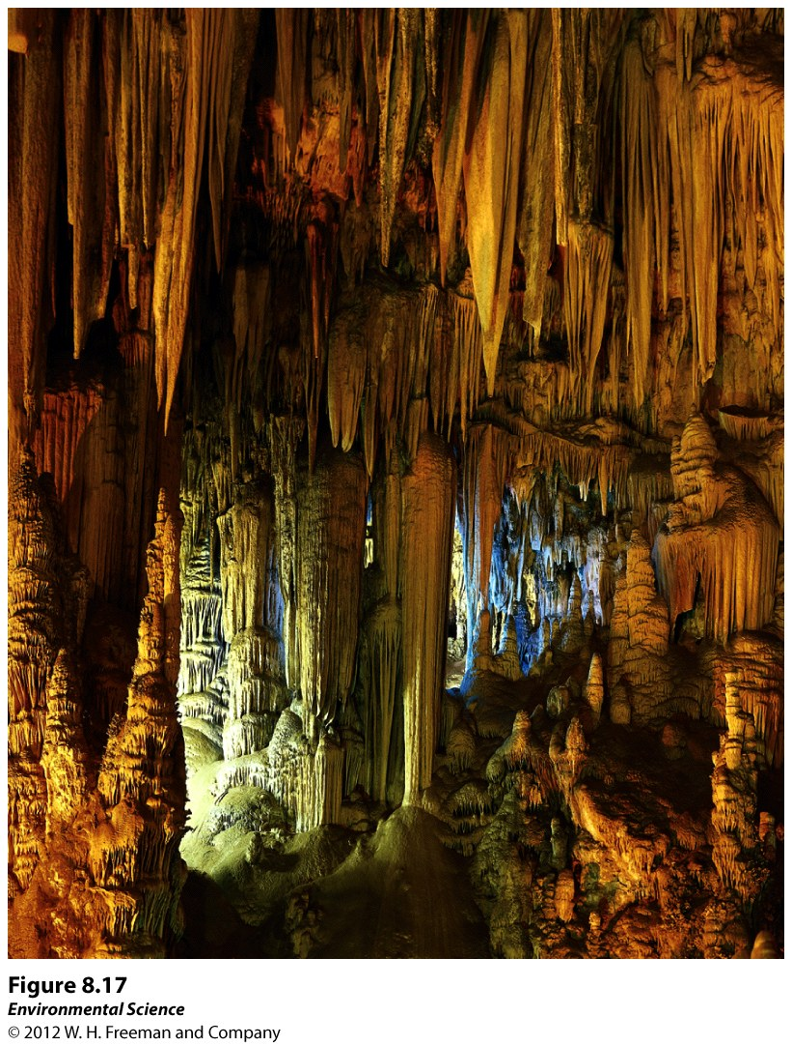
Weathering and Erosion
Chemical weathering- the breakdown of rocks and minerals by chemical reactions.

Slide 5
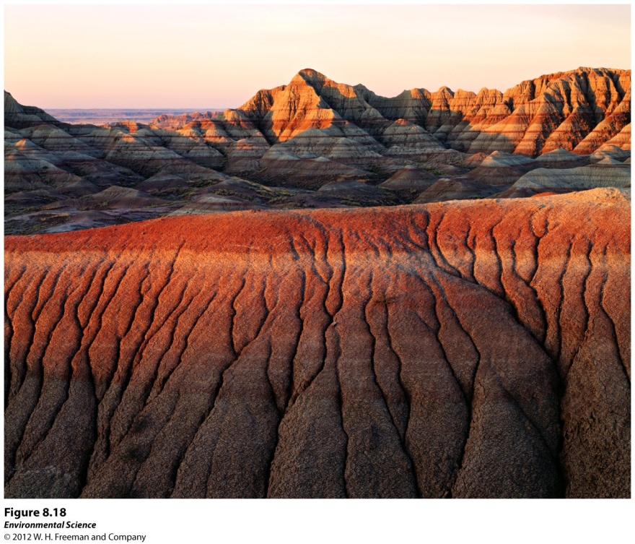
Erosion
Erosion- the physical removal of rock fragments from a landscape or ecosystem. Wind, water, ice transport and living organisms can erode materials.
Deposition- the accumulation or depositing of eroded material such as sediment, rock fragments or soil.

