Slide 1
Skeletal System
Jazmin Martinez, Kassandra Munoz, Angeline Gonzalez

Slide 2
What is the Skeletal System?
It is all of the 206 bones in the body and the tissues that go with it (tendons, ligaments, and cartilage that connect them)

Slide 3
Major Functions
Support
Movement
Protection
Blood cell production
Calcium storage
Endocrine regulation

Slide 4
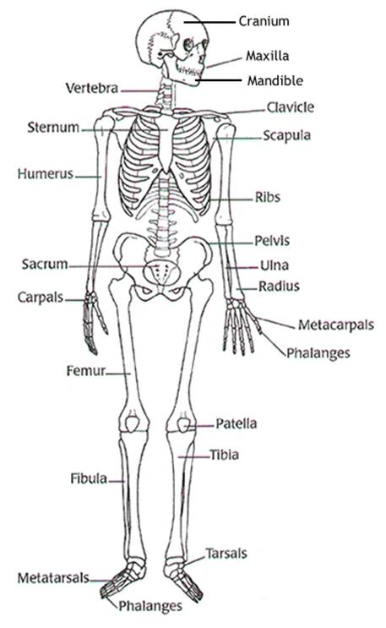
Human Body
Bones- any of the pieces of hard whitish
tissue making up the skeleton in human
and other vertebrates
Ligaments-strong inelastic bands of
connective tissue that help hold bones
and joints together
Tendons- Flexible tissue that attaches
muscle to bone

Slide 5
Joints!
Hinge joint- allows you to move back and fourth in a plane, located on the knees and elbows
Pivot joint- (rotary joint) is a circular bone that moves on the axis of another bone (allows to rotate around the other) , head, elbows
Ball-and-socket- a joint that allows rotary (rotation, go all the way around) motion in every direction, hip and shoulder

Slide 6
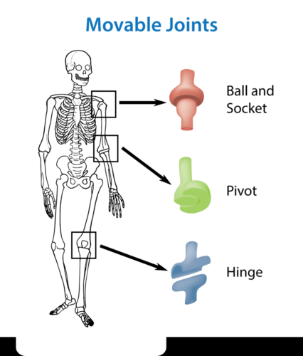
Joints!
All three joints are shown

Slide 7
Interactions with other systems
Works with integumentary to give the skin something to form on
Works with the muscular to allow movement, because the tissues and muscles attach to bone
Works with the circulatory in that the marrow inside of bones helps make the cells inside the body (both red and white)

Slide 8
5 Fun Facts
Adults have 206 bones, while babies have about 300 in their bodies
The hands and feet have over half of the body’s bones. Hands have 27 and each foot has 26.
The average adult has 24 ribs, one in every 500 people have an extra rib called the “cervical rib”
The hyroid is a bone between the chin and thyroid cartilage, it is the only bone in the body not connected to another bone
The clavicle is the most frequently broken bone in the body

