Slide 1
Soil
Soil is important because it
Is a medium for plant growth
Serves as a filter for water
A habitat for living organisms
Serves as a filter for pollutants

Slide 2
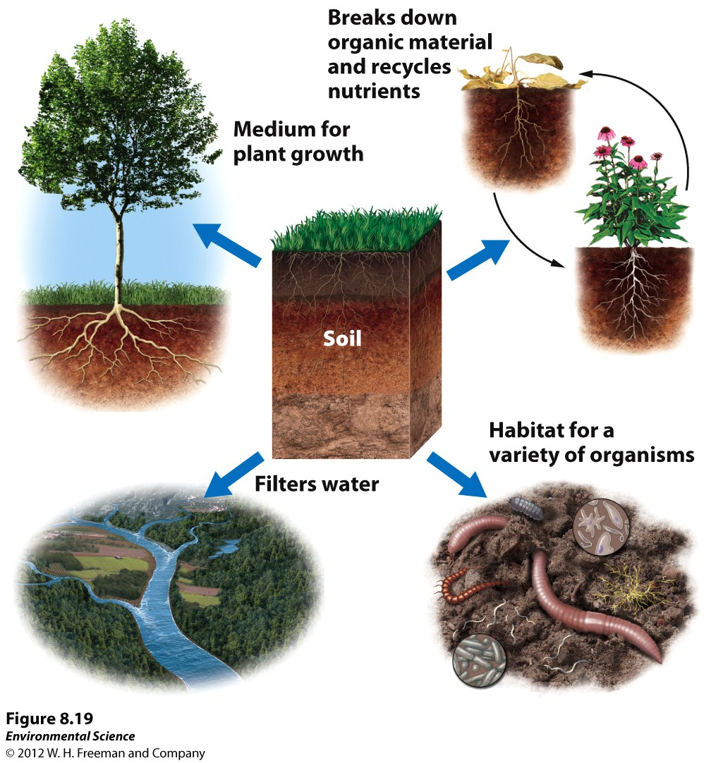

Slide 3
The Formation of Soil
Factors that determine the formation of soil:
Parent material- what the soil is made from influences soil formation
Climate- what type of climate influences soil formation
Topography- the surface and slope can influence soil formation
Organisms- plants and animals can have an effect on soil formation
Time- the amount of time a soil has spent developing can determine soil properties.

Slide 4
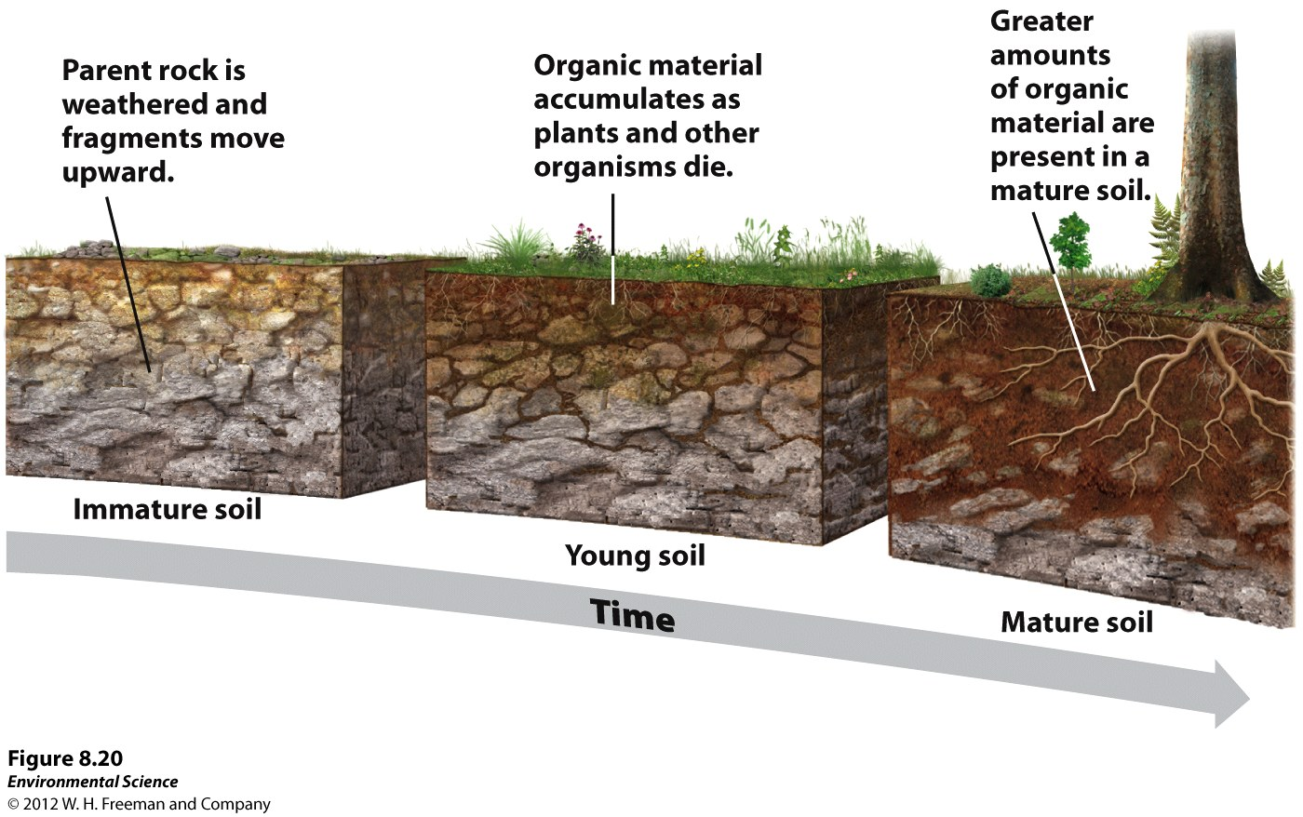
The Formation of Soil
Parent Material- the rock material from which soil is derived.

Slide 5
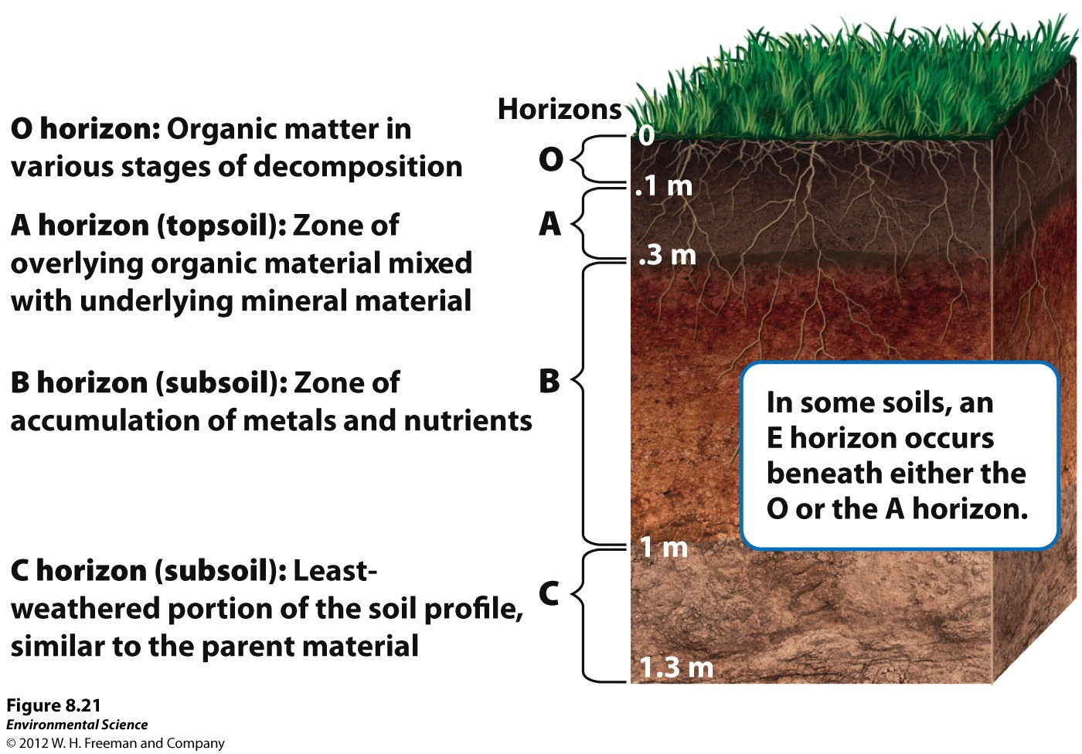
Soil Horizons
As soils form, they develop characteristics layers.

Slide 6
Soil Horizons
O horizon- (organic layer) composed of the leaves, needles, twigs and animal bodies on the surface.
A horizon- (topsoil) the zone of organic material and minerals mixed together.
B horizon- (subsoil) composed primarily of mineral material with very little organic matter
C horizon- (parent material) the least weathered horizon and is similar to the parent material.

Slide 7
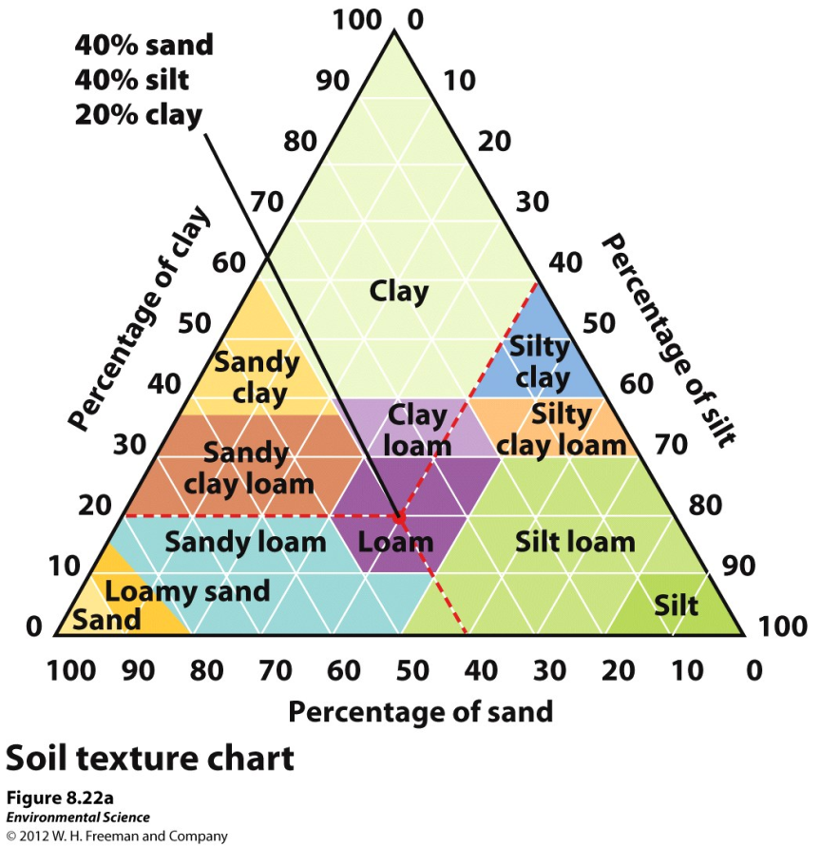
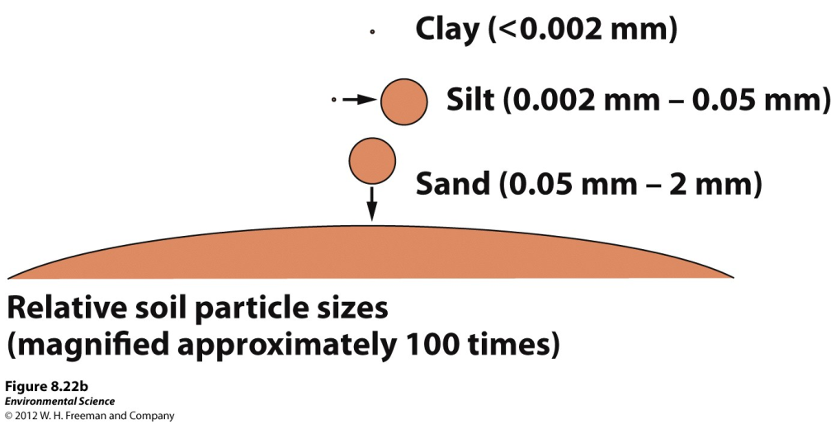
Physical Properties of Soil
Texture- the percentage of sand, silt and clay the soil contains.

Slide 8
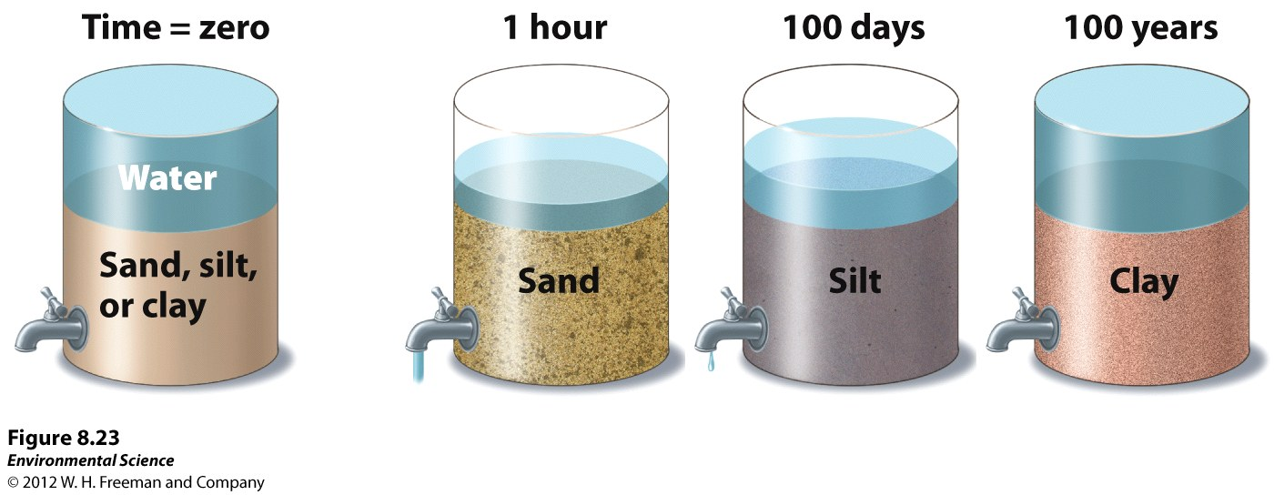
Physical Properties of Soil
Porosity- how quickly the soil drains (which depends on its texture)

Slide 9
Chemical Properties of Soil
Cation exchange capacity- the ability of a soil to adsorb and release cations, positively charged mineral ions.
Soil bases- calcium, magnesium, potassium and sodium
Soil Acids- aluminum and hydrogen
Base saturation- the proportion of soil bases to soil acids

Slide 10
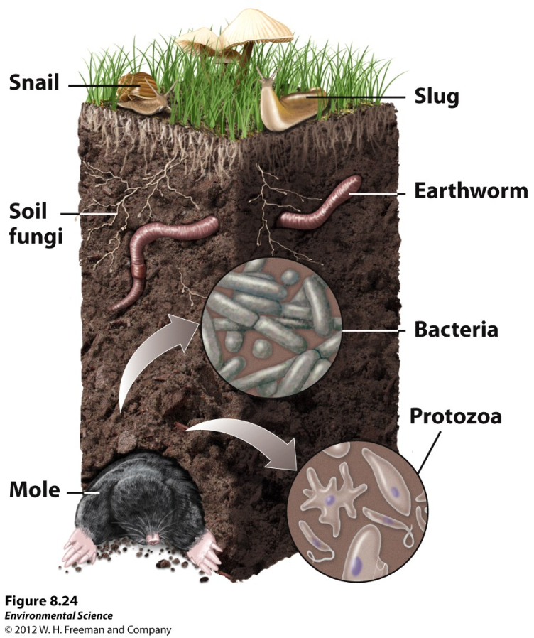
Biological Properties of Soil
Many organisms are found in the soil including fungi, bacteria, protozoans, rodents and earthworms.
10

