Slide 1
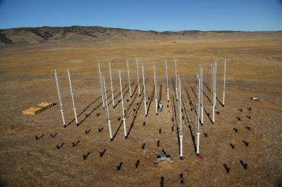
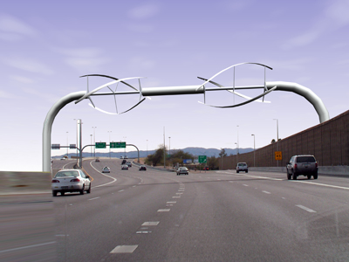
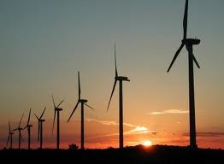
Wind Energy
vertical-axis wind turbines
Arizona
“Our universe is a sea of energy-free, clean energy. It is all out there waiting for us to set sail upon it.”
-Robert Adams

Slide 2
Wind
According to the Environmental Protection Agency (EPA):
warm air moves towards cooler air
Earth rotation + {Earth heated unevenly by sun(seasons + cloud cover)} = movement of air (aka wind!)

Slide 3
http://www1.eere.energy.gov/windandhydro/wind_animation.html

Slide 4
http://www.windpoweringamerica.gov/wind_maps.asp
8 kph (2 m/s) minimum is required to start rotating (cut-in speed) most small wind turbines
http://www.level.org.nz/energy/renewable-electricity-generation/wind-turbine-systems/

Slide 5
Benefits (according to the EPA)
No fuels are combusted and no water is necessary to create electricity (movement of blades through wind turns the generator that produces the electricity)
installed wind cost is between 2-6 cents/kWh (vs. 5-7 cents/kWh of the cheapest fossil fuel-based energy- CNG)

Slide 6
Benefits (according to National Atlas)
“Wind power helps the environment by producing electricity without producing pollution.”
“Noise, which was a problem with older turbine designs, has mostly been eliminated through improved engineering.”

Slide 7
Benefits (according to National Academies Press)
“Unlike fossil fuels, wind energy does not generate atmospheric contaminants or thermal pollution.”
“Some environmental effects of wind-energy facilities, especially those from transportation (roads to and from plants) and transmission (roads or clearings for transmission lines) are common to all electricity-generation plants.”

Slide 8
Benefits (according to the US Dept. of Energy)
The Colorado Public Service Commission conducted a study indicating that “wind energy provided the lowest cost of any new generation resource.”
An ongoing research project is trying to evaluate evidence, if any, that bats are negatively affected by wind turbines and wind farms
<1 in 30,000 birds are killed due to wind farms (as compared to the nearly 800+ in 30,000 birds dying to due to impact with residential and commercial windows.)

Slide 9
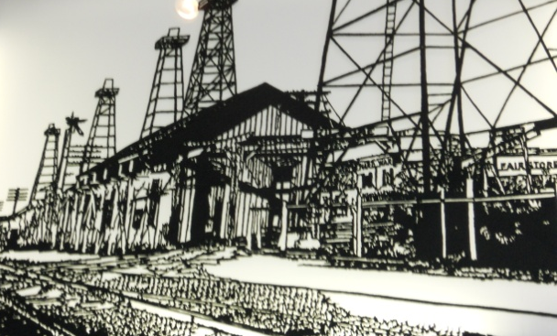
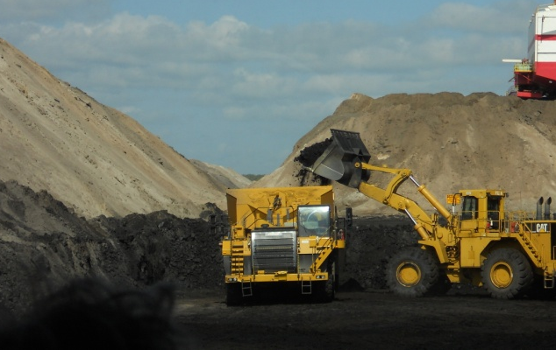
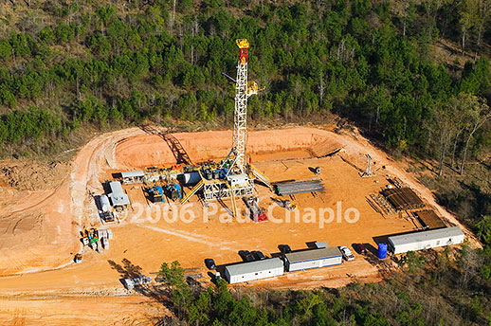
Aesthetics?
Kilgore, TX
vs
Oak Hill Mine, TX
Wolf Ridge Wind Farm, TX

Slide 10
Bat mortality
Curtailment of wind turbine speeds in peak bat traffic time accounts to only 0.3% of total annual power output (according to EB Arnett, et al

